Slide 1

Cluster-Robust Variance Estimators for Instrumental Variables
Theory and Application in Assessing the Impact of Gender Representation on Carbon Emissions
Sam Lee
04/15/2024

Slide 2
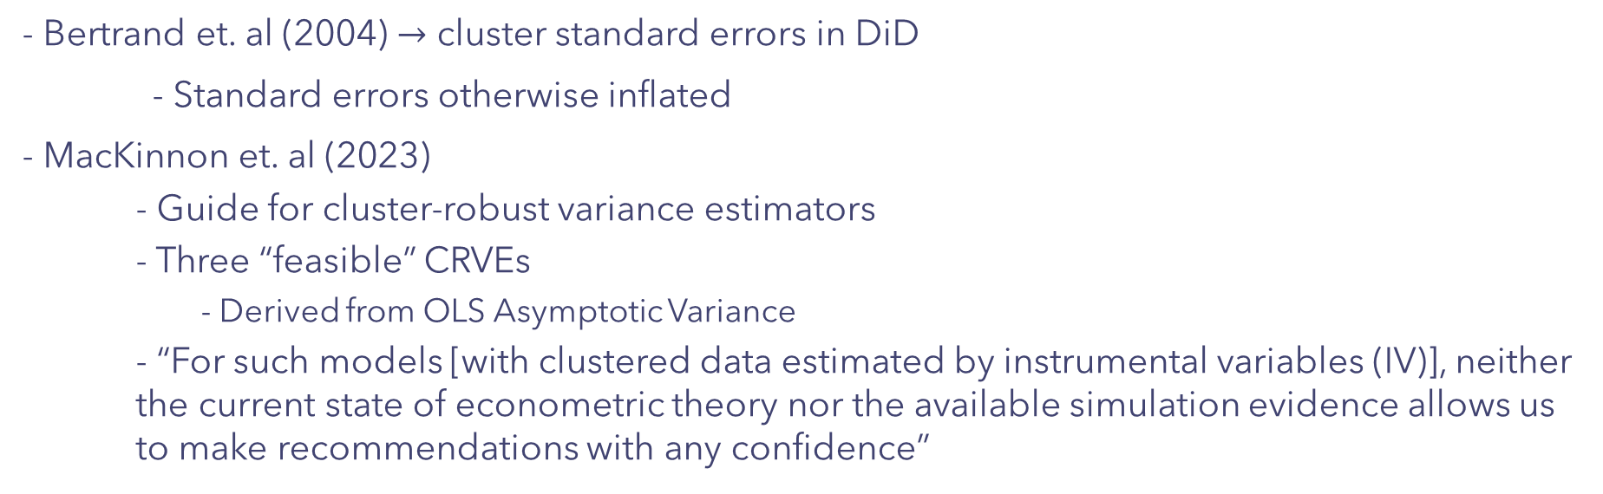
Background
- Bertrand et. al (2004) $→$ cluster standard errors in DiD
- Standard errors otherwise inflated
- MacKinnon et. al (2023)
- Guide for cluster-robust variance estimators
- Three “feasible” CRVEs
- Derived from OLS Asymptotic Variance
- “For such models [with clustered data estimated by instrumental variables (IV)], neither the current state of econometric theory nor the available simulation evidence allows us to make recommendations with any confidence”

Slide 3

Three Feasible CRVEs
Assuming data are generated at$β=β_{0}$,
$$\sqrt{n}\left(\hat{b}−β_{0}\right)\overset{→}{d}N\left(0,𝔼{\left[X_{i}X_{i}^{′}\right]}^{−1}𝔼\left[x_{i}x_{i}^{′}u_{i}^{2}\right]𝔼{\left[X_{i}X_{i}^{′}\right]}^{−1}\right)$$
Assuming data can be divided into G disjoint groups, it follows that a reasonable way to “cluster” standard errors by group (g) will depend on the residual errors from that group:
$$𝔼\left[x_{i}x_{i}^{′}u_{i}^{2}\right]≈\frac{1}{n}\sum_{i=1}^{n}{x_{i}}x_{i}^{′}{\hat{u}}_{i}^{2}→\frac{1}{n}{\sum_{g=1}^{G}{X_{g}′{\hat{u}}_{g}{\hat{u}}_{g}^{′}X_{g}}}^{}$$
Thus, the first CRVE follows as (and with a degree of freedom correction applied),
$${CV_{1}:n\frac{G(N−1)}{(G−1)(N−k)}\left(X^{′}X\right)}^{−1}\sum_{g=1}^{G}{{\hat{s}}_{g}{\hat{s}}_{g}\text{’ }}{\left(X^{′}X\right)}^{−1};{\hat{s}}_{g}=X_{g}^{′}{\hat{u}}_{g}$$

Slide 4

Three Feasible CRVEs
However, sometimes $X_{g}^{′}{\hat{u}}_{g}$ are not the best estimators for ${\hat{s}}_{g} \left(Bell \& McCaffery, 2002\right).$
Two Alternative CRVEs:
$$CV_{2}: {n\left(X^{′}X\right)}^{−1}\sum_{g=1}^{G}{{\grave{s}}_{g}{\grave{s}}_{g}\text{’ }}{\left(X^{′}X\right)}^{−1};{\grave{ s}}_{g}=X_{g}^{′}M_{gg}^{−\frac{1}{2}}{\hat{u}}_{g};M_{gg}=I_{Ng}−X_{g}{\left(X^{′}X\right)}^{−1}X_{g}′$$
$$CV_{3}: {n\frac{G−1}{G}\left(X^{′}X\right)}^{−1}\sum_{g=1}^{G}{\acute{s_{g}}\acute{s_{g}}\text{’ }}{\left(X^{′}X\right)}^{−1};\acute{s_{g}}=X_{g}^{′}M_{gg}^{−1}{\hat{u}}_{g}$$

Slide 5

A GMM Framework for Just-Identified IV
Assumptions for Identification in GMM:
$$𝔼\left[m_{i}\left(β\right)=Z_{i}\left(Y_{i}−X_{i}^{′}β\right)\right]=0; G\left(β\right)≔\left[\frac{∂m_{i}\left(β\right)}{∂β^{′}}\right]=−𝔼\left[Z_{i}X_{i}^{′}\right] \left(\text{has} \text{rank} \text{k}\right)$$
$$\sqrt{n}\left(\hat{b}−β_{0}\right)\overset{→}{d}N\left(0,{\left[G\left(β\right)𝔼{\left[m_{i}\left(β\right)m_{i}{\left(β\right)}^{′}\right]}^{−1}G{\left(β\right)}^{′}\right]}^{−1}\right)→\sqrt{n}\left(\hat{b}−β_{0}\right)\overset{→}{d}N\left({\left[𝔼\left[Z_{i}X_{i}^{′}\right]𝔼\left[Z_{i}Z_{i}^{′}u_{i}^{2}\right]𝔼{\left[Z_{i}X_{i}^{′}\right]}^{′}\right]}^{−1}\right)$$
2SLS Variance Estimator with Homoskedasticity:
$$\hat{V}={\left[\left(\frac{1}{n}X^{′}Z\right){\left(\frac{1}{n}Z^{′}Z{\hat{u}}_{2}\right)}^{−1}{\left(\frac{1}{n}X^{′}Z\right)}^{′}\right]}^{−1}$$

Slide 6

Proposed CRVEs for GMM
For G disjoint clusters,
$${\hat{V}}_{g}={\left[\left(\frac{1}{n}X^{′}Z\right){\left(\frac{1}{n}\sum_{g=1}^{G}{Z_{g}^{′}{\hat{u}}_{g}}{{\hat{u}}_{g}′Z}_{g}^{}\right)}^{−1}{\left(\frac{1}{n}X^{′}Z\right)}^{′}\right]}^{−1}$$
Thus, following MacKinnon et. al, all three CRVEs can be rewritten as follows:
$${­iv \atop CV_{1}}:n\frac{G\left(N−1\right)}{\left(G−1\right)\left(N−k\right)}{\left[\left(X^{′}Z\right){\left(\sum_{g=1}^{G}{{\hat{ζ}}_{g}{\hat{ζ}}_{g}′}\right)}^{−1}{\left(X^{′}Z\right)}^{′}\right]}^{−1}; {\hat{ζ}}_{g}=Z_{g}^{′}\hat{u_{g}}$$

Slide 7

Proposed CRVEs for GMM
$${­iv \atop CV_{2}}:n{\left[\left(X^{′}Z\right){\left(\sum_{g=1}^{G}{\grave{ζ_{g}}\grave{ζ_{g}}′}\right)}^{−1}{\left(X^{′}Z\right)}^{′}\right]}^{−1}; \grave{ζ_{g}}=Z_{g}^{′}M_{gg}^{−\frac{1}{2}}{\hat{u}}_{g};M_{gg}=I_{Ng}−Z_{g}{\left(Z^{′}Z\right)}^{−1}Z_{g}′$$
$${­iv \atop CV_{3}}:n\frac{G−1}{G}{\left[\left(X^{′}Z\right){\left(\sum_{g=1}^{G}{{\acute{ζ}}_{g}{\acute{ζ}}_{g}′}\right)}^{−1}{\left(X^{′}Z\right)}^{′}\right]}^{−1}; {\acute{ζ}}_{g}=Z_{g}^{′}M_{gg}^{−1}{\hat{u}}_{g}$$

Slide 8

An Applied Example
What is the effect that electing higher proportions of women into national legislatures in African and Arab nations has on yearly per capita $CO_{2}$ emissions?
- Women are disproportionately affected by negative externalities of climate change
- One recent paper suggests a causal link between higher proportions of women in parliament and stricter climate policies (Mavisakalyan & Tarverdi, 2019)
- Uses cross-sectional data-set
- Intertemporal link?

Slide 9

Identification Strategy
Two-stage difference-in-differences:
$$\left(1\right){ W}_{ct−1}=π_{0}+λZ_{ct−1}+\sum_{p=2}^{P}{X_{ct−p}^{′}Ψ_{p}}+$$
$$\sum_{k=\text{Angola} k≠\text{Qatar}\text{, }\text{Iraq}}^{Zimbabwe}{μ_{k}𝟙\left({\text{Country}}_{c}=k\right)}+\sum_{j=1999}^{2022}{η_{j}𝟙\left({\text{Year}}_{t}=j\right)}+v_{ct}$$
$$\left(2\right){ Y}_{ct}=β_{0}+δW_{ct−1}+\sum_{p=2}^{P}{X_{ct−p}^{′}Ω_{p}}+$$
$$\sum_{k=\text{Angola}\text{; }k≠\text{Qatar}\text{, }\text{Iraq}}^{Zimbabwe}{β_{k}𝟙\left({\text{Country}}_{c}=k\right)}+\sum_{j=1999}^{2022}{γ_{j}𝟙\left({\text{Year}}_{t}=j\right)}+ϵ_{ct}$$

Slide 10
Identification Strategy
Two-stage difference-in-differences:
$$\left(1\right){ W}_{ct−1}=π_{0}+λZ_{ct−1}+\sum_{p=2}^{P}{X_{ct−p}^{′}Ψ_{p}}+$$
$$\sum_{k=\text{Angola} k≠\text{Qatar}\text{, }\text{Iraq}}^{Zimbabwe}{μ_{k}𝟙\left({\text{Country}}_{c}=k\right)}+\sum_{j=1999}^{2022}{η_{j}𝟙\left({\text{Year}}_{t}=j\right)}+v_{ct}$$
$$\left(2\right){ Y}_{ct}=β_{0}+δW_{ct−1}+\sum_{p=2}^{P}{X_{ct−p}^{′}Ω_{p}}+$$
$$\sum_{k=\text{Angola}\text{; }k≠\text{Qatar}\text{, }\text{Iraq}}^{Zimbabwe}{β_{k}𝟙\left({\text{Country}}_{c}=k\right)}+\sum_{j=1999}^{2022}{γ_{j}𝟙\left({\text{Year}}_{t}=j\right)}+ϵ_{ct}$$
Endogenous Treatment

Slide 11
Identification Strategy
Instrumental Variable – Years Since Country was Granted Suffrage
Two-stage difference-in-differences:
$$\left(1\right){ W}_{ct−1}=π_{0}+λZ_{ct−1}+\sum_{p=2}^{P}{X_{ct−p}^{′}Ψ_{p}}+$$
$$\sum_{k=\text{Angola} k≠\text{Qatar}\text{, }\text{Iraq}}^{Zimbabwe}{μ_{k}𝟙\left({\text{Country}}_{c}=k\right)}+\sum_{j=1999}^{2022}{η_{j}𝟙\left({\text{Year}}_{t}=j\right)}+v_{ct}$$
$$\left(2\right){ Y}_{ct}=β_{0}+δW_{ct−1}+\sum_{p=2}^{P}{X_{ct−p}^{′}Ω_{p}}+$$
$$\sum_{k=\text{Angola}\text{; }k≠\text{Qatar}\text{, }\text{Iraq}}^{Zimbabwe}{β_{k}𝟙\left({\text{Country}}_{c}=k\right)}+\sum_{j=1999}^{2022}{γ_{j}𝟙\left({\text{Year}}_{t}=j\right)}+ϵ_{ct}$$

Slide 12
Identification Strategy
Two-stage difference-in-differences:
$$\left(1\right){ W}_{ct−1}=π_{0}+λZ_{ct−1}+\sum_{p=2}^{P}{X_{ct−p}^{′}Ψ_{p}}+$$
$$\sum_{k=\text{Angola} k≠\text{Qatar}\text{, }\text{Iraq}}^{Zimbabwe}{μ_{k}𝟙\left({\text{Country}}_{c}=k\right)}+\sum_{j=1999}^{2022}{η_{j}𝟙\left({\text{Year}}_{t}=j\right)}+v_{ct}$$
$$\left(2\right){ Y}_{ct}=β_{0}+δW_{ct−1}+\sum_{p=2}^{P}{X_{ct−p}^{′}Ω_{p}}+$$
$$\sum_{k=\text{Angola}\text{; }k≠\text{Qatar}\text{, }\text{Iraq}}^{Zimbabwe}{β_{k}𝟙\left({\text{Country}}_{c}=k\right)}+\sum_{j=1999}^{2022}{γ_{j}𝟙\left({\text{Year}}_{t}=j\right)}+ϵ_{ct}$$
Response Variable – Per Capita Carbon Emissions for a country c in year t

Slide 13
Identification Strategy
Two-stage difference-in-differences:
$$\left(1\right){ W}_{ct−1}=π_{0}+λZ_{ct−1}+\sum_{p=2}^{P}{X_{ct−p}^{′}Ψ_{p}}+$$
$$\sum_{k=\text{Angola} k≠\text{Qatar}\text{, }\text{Iraq}}^{Zimbabwe}{μ_{k}𝟙\left({\text{Country}}_{c}=k\right)}+\sum_{j=1999}^{2022}{η_{j}𝟙\left({\text{Year}}_{t}=j\right)}+v_{ct}$$
$$\left(2\right){ Y}_{ct}=β_{0}+δW_{ct−1}+\sum_{p=2}^{P}{X_{ct−p}^{′}Ω_{p}}+$$
$$\sum_{k=\text{Angola}\text{; }k≠\text{Qatar}\text{, }\text{Iraq}}^{Zimbabwe}{β_{k}𝟙\left({\text{Country}}_{c}=k\right)}+\sum_{j=1999}^{2022}{γ_{j}𝟙\left({\text{Year}}_{t}=j\right)}+ϵ_{ct}$$
A sequence of autoregressive lags on economic covariates

Slide 14
Identification Strategy
Two-stage difference-in-differences:
$$\left(1\right){ W}_{ct−1}=π_{0}+λZ_{ct−1}+\sum_{p=2}^{P}{X_{ct−p}^{′}Ψ_{p}}+$$
$$\sum_{k=\text{Angola} k≠\text{Qatar}\text{, }\text{Iraq}}^{Zimbabwe}{μ_{k}𝟙\left({\text{Country}}_{c}=k\right)}+\sum_{j=1999}^{2022}{η_{j}𝟙\left({\text{Year}}_{t}=j\right)}+v_{ct}$$
$$\left(2\right){ Y}_{ct}=β_{0}+δW_{ct−1}+\sum_{p=2}^{P}{X_{ct−p}^{′}Ω_{p}}+$$
$$\sum_{k=\text{Angola}\text{; }k≠\text{Qatar}\text{, }\text{Iraq}}^{Zimbabwe}{β_{k}𝟙\left({\text{Country}}_{c}=k\right)}+\sum_{j=1999}^{2022}{γ_{j}𝟙\left({\text{Year}}_{t}=j\right)}+ϵ_{ct}$$
Country and year fixed effects (difference-in-differences)

Slide 15
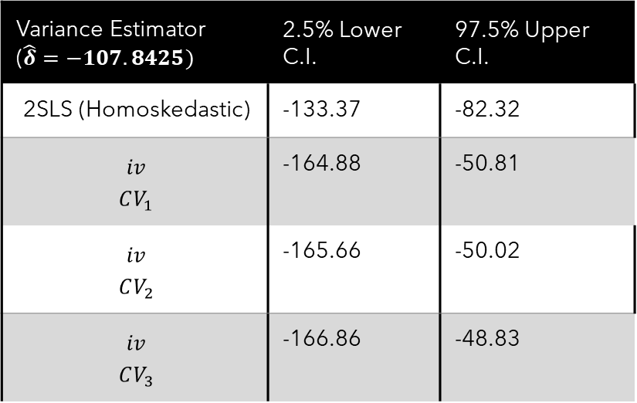
Regression Results
Variance Estimator ($\hat{δ}=−107.8425)$ | 2.5% Lower C.I. | 97.5% Upper C.I.
2SLS (Homoskedastic) | -133.37 | -82.32
$${­iv \atop CV_{1}}$$ | -164.88 | -50.81
$${­iv \atop CV_{2}}$$ | -165.66 | -50.02
$${­iv \atop CV_{3}}$$ | -166.86 | -48.83
Do we trust these results?
How do we know which CRVE to use?

Slide 16

Monte Carlo Analysis
- Assess empirical performance of CRVEs via simulation.
- Randomly generate a new (placebo) vector for $Y_{ct}$. (Leave $𝕏_{ct}$ matrix the same)
- Calculate regression coefficients and respective 95% confidence intervals for each generation.
- Calculate empirical coverage for each estimator
- Evaluate whether inference using each of the CRVEs (if any) are reliable

Slide 17

Monte Carlo Analysis - DGP
The data-generating process for $Y_{ct}$ will follow a bootstrap sampling process.
- Replace the empirical sample $Y_{ct}$ with a new bootstrap sample of $Y_{ct}$ each generation, defined as ${\dot{Y}}_{ct}$.
Let ${\dot{Y}}_{ct}$ be defined as
$${{\dot{Y}}_{ct}=\{{\dot{y}}_{ct}\}}_{c=\text{Angola}\text{, }t=1999}^{c=\text{Zimbabwe}\text{, }\text{t}\text{=2022}}=\{{\dot{y}}_{Angola, 1999},{\dot{y}}_{Angola, 2000}, …,{\dot{y}}_{Zimbabwe, 2022}\}$$
$$\operatorname{Pr}\left({\dot{y}}_{ct}=y_{ct}\right)=\frac{1}{n},∀c, t$$

Slide 18
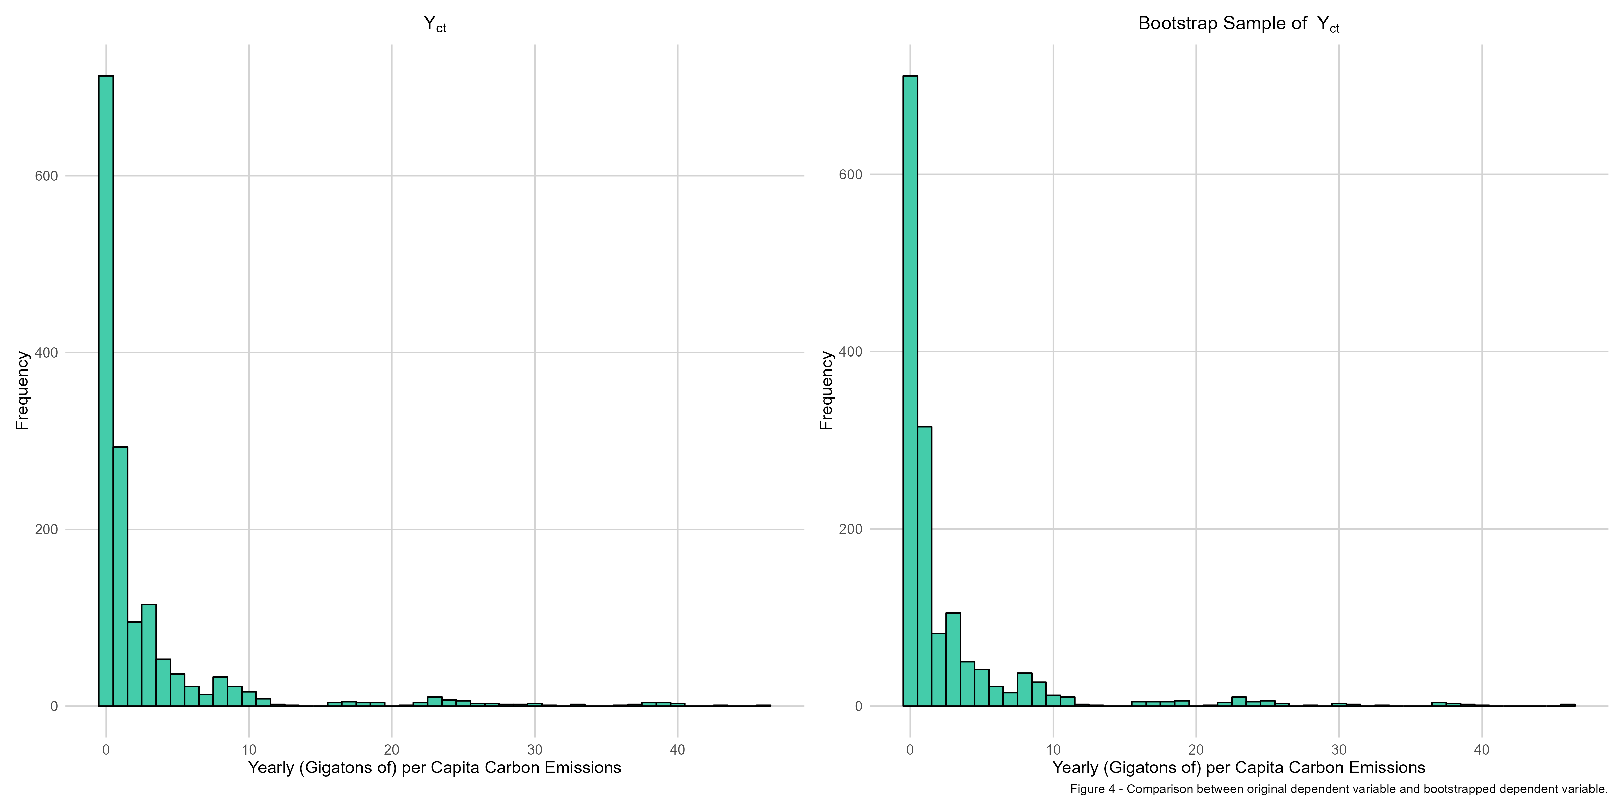
Monte Carlo Analysis - DGP

Slide 19
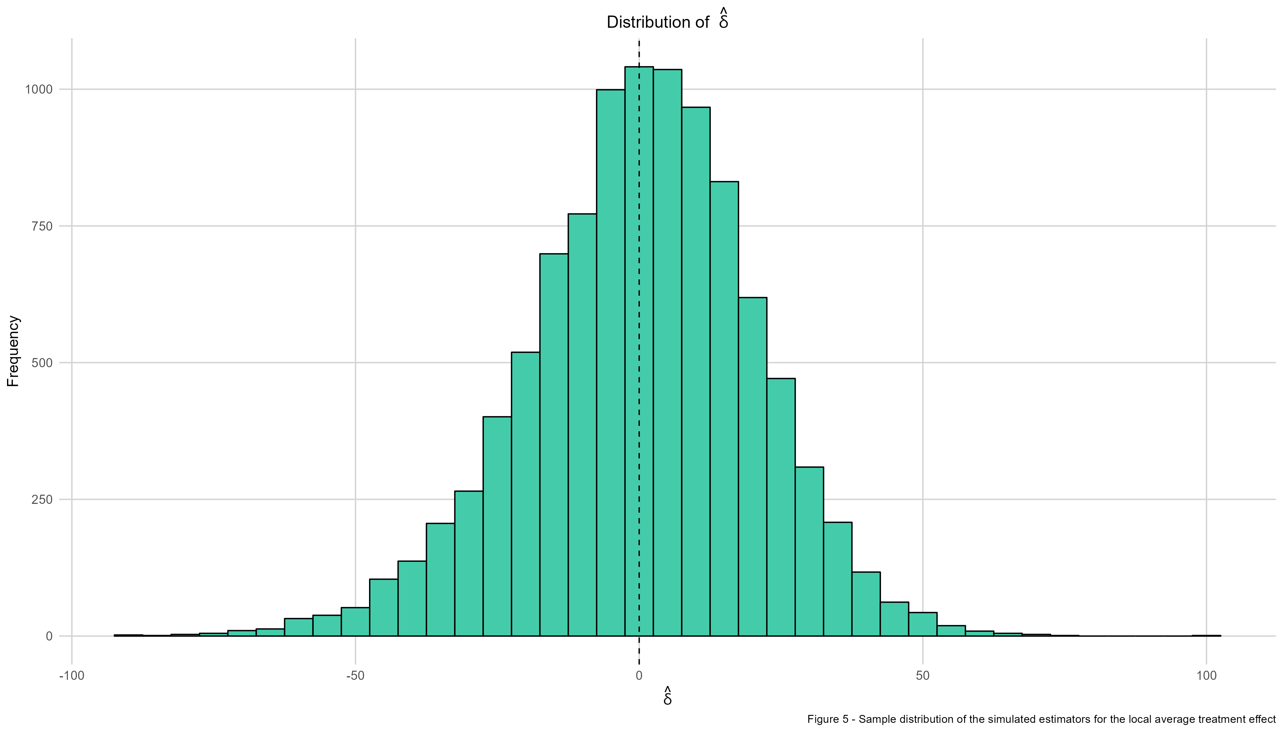
Monte Carlo Analysis – Simulation (n=10000)

Slide 20
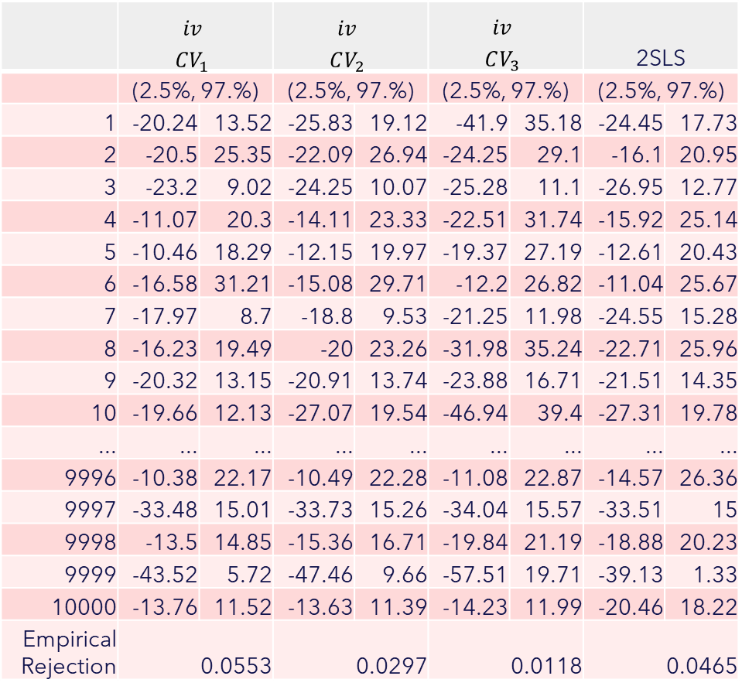
Monte Carlo Analysis – Simulation (n=10000)
 | $${­iv \atop CV_{1}}$$ |  | $${­iv \atop CV_{2}}$$ |  | $${­iv \atop CV_{3}}$$ |  | 2SLS
 | (2.5%, 97.%) |  | (2.5%, 97.%) |  | (2.5%, 97.%) |  | (2.5%, 97.%)
1 | -20.24 | 13.52 | -25.83 | 19.12 | -41.9 | 35.18 | -24.45 | 17.73
2 | -20.5 | 25.35 | -22.09 | 26.94 | -24.25 | 29.1 | -16.1 | 20.95
3 | -23.2 | 9.02 | -24.25 | 10.07 | -25.28 | 11.1 | -26.95 | 12.77
4 | -11.07 | 20.3 | -14.11 | 23.33 | -22.51 | 31.74 | -15.92 | 25.14
5 | -10.46 | 18.29 | -12.15 | 19.97 | -19.37 | 27.19 | -12.61 | 20.43
6 | -16.58 | 31.21 | -15.08 | 29.71 | -12.2 | 26.82 | -11.04 | 25.67
7 | -17.97 | 8.7 | -18.8 | 9.53 | -21.25 | 11.98 | -24.55 | 15.28
8 | -16.23 | 19.49 | -20 | 23.26 | -31.98 | 35.24 | -22.71 | 25.96
9 | -20.32 | 13.15 | -20.91 | 13.74 | -23.88 | 16.71 | -21.51 | 14.35
10 | -19.66 | 12.13 | -27.07 | 19.54 | -46.94 | 39.4 | -27.31 | 19.78
... | ... | ... | ... | ... | ... | ... | ... | ...
9996 | -10.38 | 22.17 | -10.49 | 22.28 | -11.08 | 22.87 | -14.57 | 26.36
9997 | -33.48 | 15.01 | -33.73 | 15.26 | -34.04 | 15.57 | -33.51 | 15
9998 | -13.5 | 14.85 | -15.36 | 16.71 | -19.84 | 21.19 | -18.88 | 20.23
9999 | -43.52 | 5.72 | -47.46 | 9.66 | -57.51 | 19.71 | -39.13 | 1.33
10000 | -13.76 | 11.52 | -13.63 | 11.39 | -14.23 | 11.99 | -20.46 | 18.22
Empirical Rejection | 0.0553 |  | 0.0297 |  | 0.0118 |  | 0.0465

Slide 21
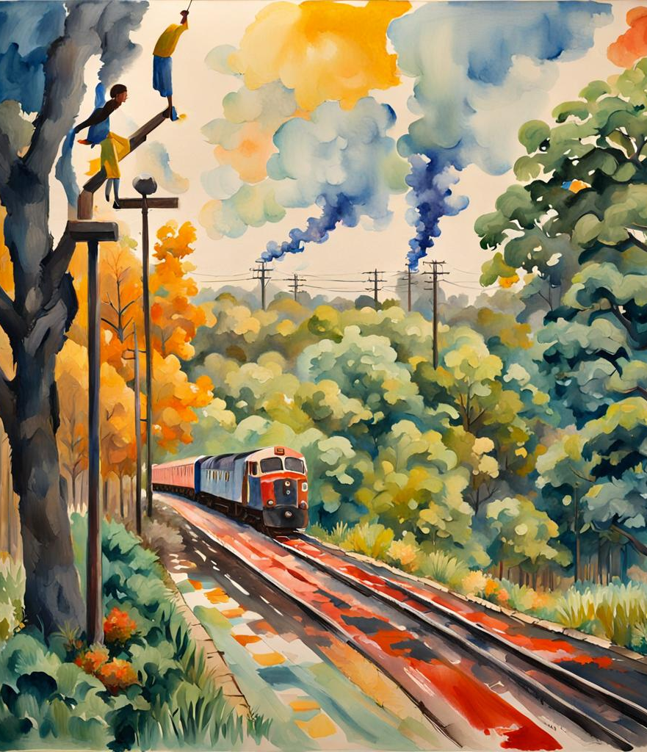
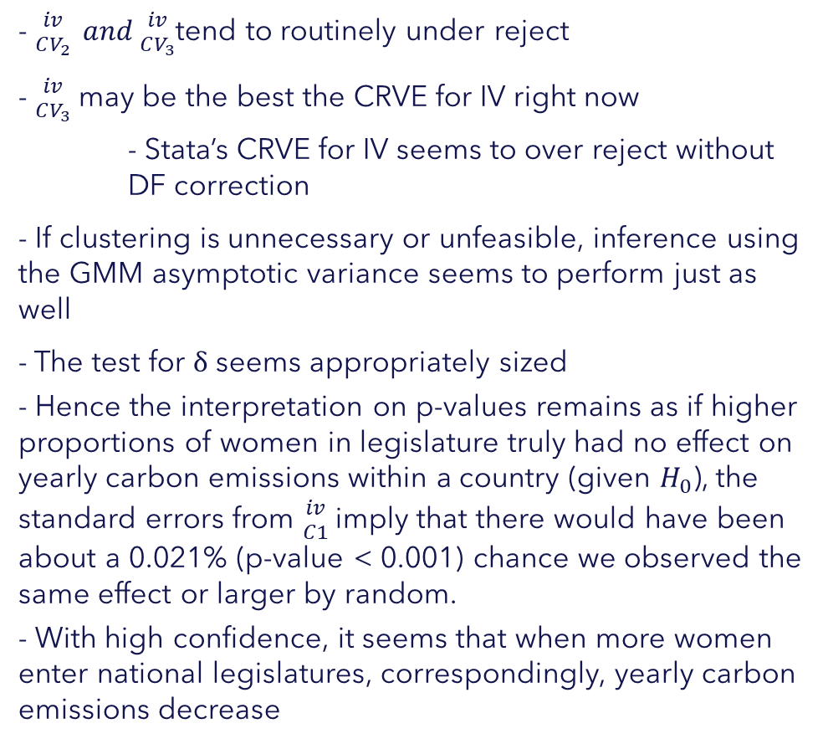
Conclusions
- ${­iv \atop CV_{2}} and{­iv \atop CV_{3}}$tend to routinely under reject
- ${­iv \atop CV_{3}}$ may be the best the CRVE for IV right now
- Stata’s CRVE for IV seems to over reject without DF correction
- If clustering is unnecessary or unfeasible, inference using the GMM asymptotic variance seems to perform just as well
- The test for $δ$ seems appropriately sized
- Hence the interpretation on p-values remains as if higher proportions of women in legislature truly had no effect on yearly carbon emissions within a country (given $H_{0}$), the standard errors from ${­iv \atop C1}$ imply that there would have been about a 0.021% (p-value < 0.001) chance we observed the same effect or larger by random.
- With high confidence, it seems that when more women enter national legislatures, correspondingly, yearly carbon emissions decrease

